Slide 1
San Francisco House Price vs Venues near by
IBM Applied Data science capstone final project
By Robin Chung

Slide 2
Introduction
In the past few years, the housing price is booming in many US cities. There are many new potential home buyers are looking for a new home with bargain price in different city or different area within the same city. The housing price can be checked from many public sources directly, but the reason of housing price is not obvious.
The objective of this study is trying to uncover the hidden reason of the housing price. Base on the learning of this course and the requirement of this project. This study is trying to find out the relationship between the housing price and top venues of different area in the same city.
The audience is any potential home buyer and they can use the result of this study as a reference to search for the bargain home price.
Notes:
Introduction where you discuss the business problem and who would be interested in this project.

Slide 3
Data
Since this study will compare the housing price of zip codes in San Francisco with top venues per zip code, the following data are required.
San Francisco Zip codes with Neighborhood name from healthysf.org
http://www.healthysf.org/bdi/outcomes/zipmap.htm
Venue data per each zip code from FourSquare API
https://foursquare.com/
Housing price per zip code in San Francisco from Porperty Shark
https://www.propertyshark.com/Real-Estate-Reports/2017/09/28/expensive-zip-codes-san-francisco/
Notes:
Data where you describe the data that will be used to solve the problem and the source of the data.

Slide 4
Methodology
In order to retrieve the data and process the data, the followings are the tools and steps.
Use BeautifulSoup to get the zip code and neighborhood name from the web.
Use geolocator.geocode to get latitude and longitude for each zipcode.
Use folium.Map to create a San Francisco map with blue dot for 20 zipcodes.
Use Python and Pandas to process and clean the data
Use Foursquare api to get the top venues from all 20 zipcodes within 500 meters of each zipcode geolocation.
Use KMeans Cluster machine learning from sklearn to categorize the zipcodes with top venues into different cluster.
Use folium.Map to create a San Francisco map and zipcodes with different color for different cluster.
Notes:
Methodology section which represents the main component of the report where you discuss and describe any exploratory data analysis that you did, any inferential statistical testing that you performed, if any, and what machine learnings were used and why.

Slide 5
Result – Table – Compare Housing price ranking and cluster Label grouping
PostalCode | Neighborhood | Rank | Cluster | MEDIAN PRICE PER SQFT 2017
94108 | Chinatown | 1 | 0 | 1189
94123 | Marina | 2 | 0 | 1188
94114 | Castro | 3 | 0 | 1157
94133 | North Beach | 4 | 0 | 1089
94117 | Haight | 5 | 0 | 1086
94118 | Inner Richmond | 6 | 0 | 1071
94115 | Western Addition | 7 | 0 | 1040
94107 | Potrero Hill | 8 | 0 | 1035
94131 | Twin Peaks | 9 | 1 | 1021
94102 | Hayes Valley | 10 | 0 | 1005
94103 | South of Market | 11 | 0 | 1003
94109 | Polk | 12 | 0 | 992
94127 | St. Francis Wood | 13 | 0 | 991
94121 | Outer Richmond | 14 | 0 | 899
94116 | Parkside | 15 | 0 | 890
94122 | Sunset | 16 | 0 | 870
94132 | Lake Merced | 17 | 0 | 785
94112 | Ingelside | 18 | 0 | 714
94134 | Visitacion Valley | 19 | 0 | 627
94124 | Bayview | 20 | 2 | 596
Comparing the Housing price ranking and Cluster label. One cluster group #2 is at the lowest ranking for housing price. By using venues for clustering may still be able to find out the worst housing price area, but there is no linear relationship between housing price and venues.
There is one outliner is Zip code 94131 and it has cluster label #1, but the housing price ranking is in the middle ranking. There may be some other factor is causing the housing price at that level instead of only venues near by. I know this place which is at the top of the maintain which has less shops and very quiet.

Slide 6
Discussion - Table - Clustering from from Kmeans Machine Learning
The following table is the clustering result from Kmeans (K=5) . The main output is Cluster labels for each zip code. The last 5 columns have the top 5 most common venue for each zip. The observation is coffee shop or café are very common in cluster label 0. Cluster label 0 has the highest housing price in San Francisco.
PostalCode | Neighborhood | Cluster Labels | 1st Most Common Venue | 2nd Most Common Venue | 3rd Most Common Venue | 4th Most Common Venue | 5th Most Common Venue
94102 | Hayes Valley | 0 | Boutique | Hotel | Women's Store | Clothing Store | Cocktail Bar
94132 | Lake Merced | 0 | Pizza Place | Cosmetics Shop | Bakery | Coffee Shop | Juice Bar
94127 | St. Francis Wood | 0 | Pub | Coffee Shop | Gym / Fitness Center | Italian Restaurant | Wine Bar
94123 | Marina | 0 | Cosmetics Shop | Spa | Yoga Studio | Italian Restaurant | Burger Joint
94122 | Sunset | 0 | Coffee Shop | Japanese Restaurant | Chinese Restaurant | Yoga Studio | Trail
94121 | Outer Richmond | 0 | Café | Convenience Store | Chinese Restaurant | Pharmacy | Pizza Place
94118 | Inner Richmond | 0 | Coffee Shop | Café | Chinese Restaurant | Sushi Restaurant | Bank
94133 | North Beach | 0 | Italian Restaurant | Bakery | Coffee Shop | Pizza Place | Café
94117 | Haight | 0 | Park | Liquor Store | Dog Run | Coffee Shop | Sandwich Place
94115 | Western Addition | 0 | Spa | Café | Grocery Store | Gift Shop | Bakery
94114 | Castro | 0 | Gay Bar | Thai Restaurant | Coffee Shop | Park | New American Restaurant
94112 | Ingelside | 0 | Bus Station | Asian Restaurant | Metro Station | Food Truck | New American Restaurant
94109 | Polk | 0 | Bar | Grocery Store | Italian Restaurant | Coffee Shop | Bakery
94108 | Chinatown | 0 | Hotel | Coffee Shop | Boutique | Clothing Store | Tea Room
94107 | Potrero Hill | 0 | Hotel | Boutique | Coffee Shop | Jewelry Store | Clothing Store
94103 | South of Market | 0 | Nightclub | Cocktail Bar | Art Gallery | Coffee Shop | Gay Bar
94116 | Parkside | 0 | Light Rail Station | Gas Station | Chinese Restaurant | Martial Arts School | Paintball Field
94134 | Visitacion Valley | 0 | Rental Car Location | Pizza Place | Coffee Shop | Laundromat | Gas Station
94131 | Twin Peaks | 1 | Trail | Scenic Lookout | Garden | Reservoir | Hill
94124 | Bayview | 2 | Pier | Café | Nightclub | Sandwich Place | Brazilian Restaurant
Notes:
Results section where you discuss the results.

Slide 7
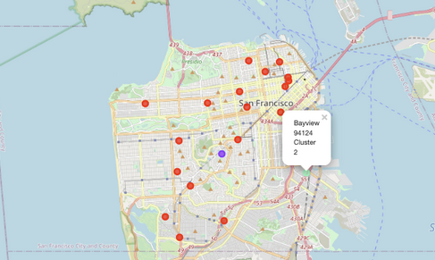
Obervation – By looking at the location of the lowest housing price and cluster label 2

Slide 8
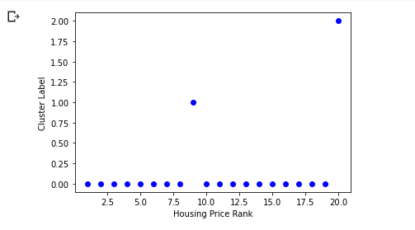
Conclusion
Base on the Kmeans clustering result, we can concluded that there is a relationship between the top venues and housing price. However, the clustering result is more effective to identify the area with lowest housing price values.
Home buyers can still use the clustering result to look for a bargaining house price in cluster label 0. For example, house price ranking 11 to 19 have lower price than ranking 1 to 10 and they have the similar top venues.
Thanks for spending time to read my presentation! Other than the house price study. I am able to learn different technique in order to complete this study.

Slide 9
Github link for this notebook
https://github.com/robinmkc/Coursera_Capstone/blob/60fff91fbbd24e00636c3927d19359990f6a2060/Data_scientist_capstone_week5_final.ipynb

